Slide 1
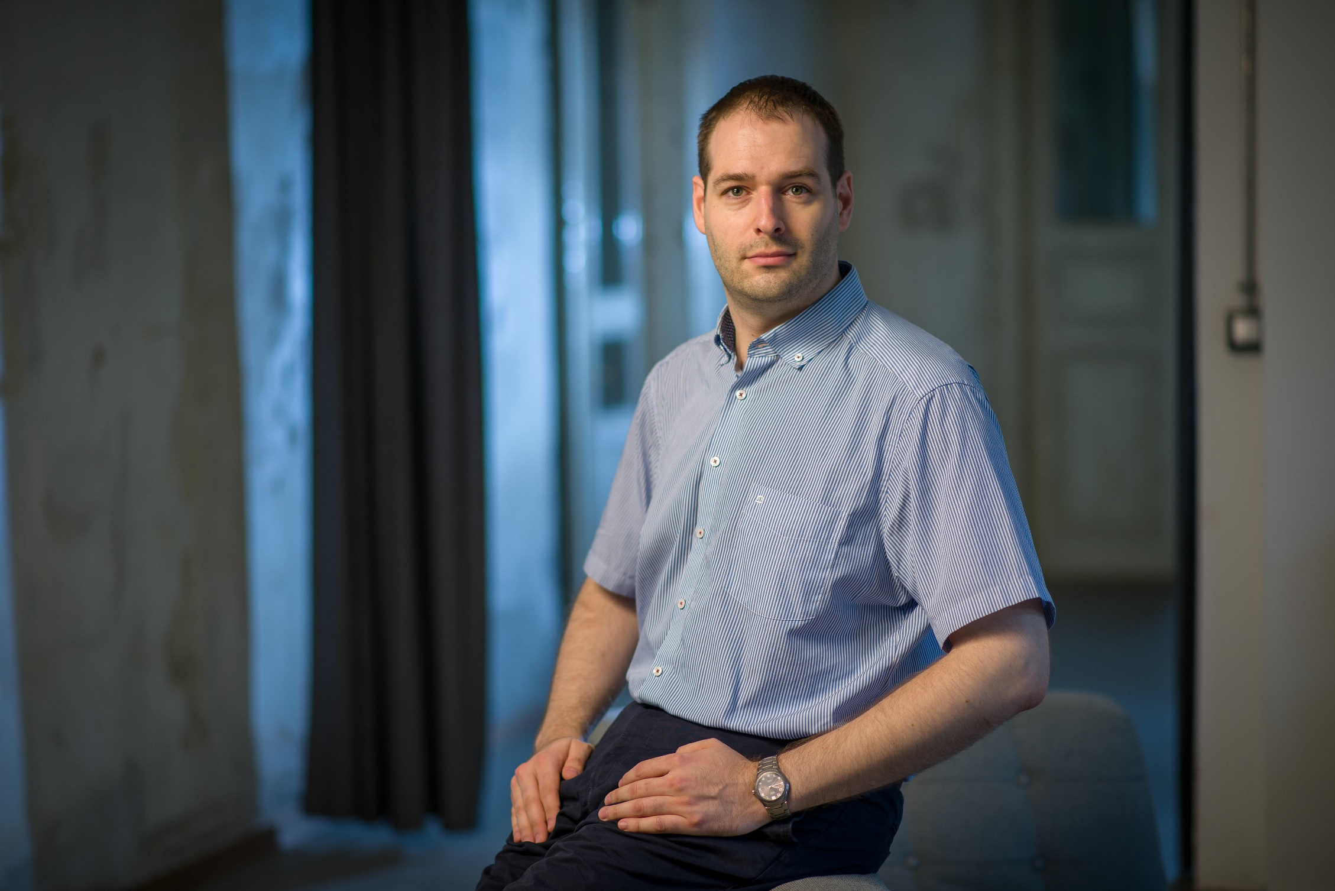
Peter Horgas
BME –
Mechanical engineer
but not finished… :(
System administrator
Laptop service technician
& parts salesman

Slide 2
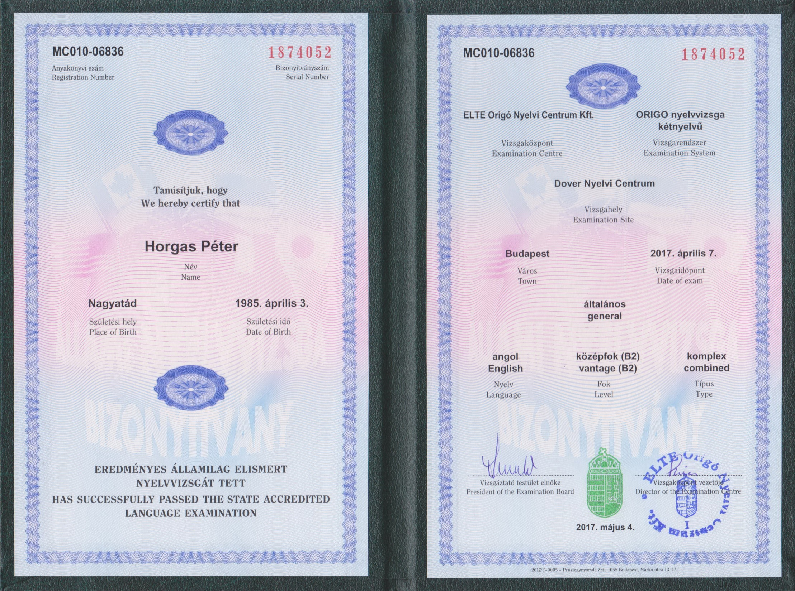

Slide 3
The last
4 or 3 weeks…
Peter Horgas

Slide 4
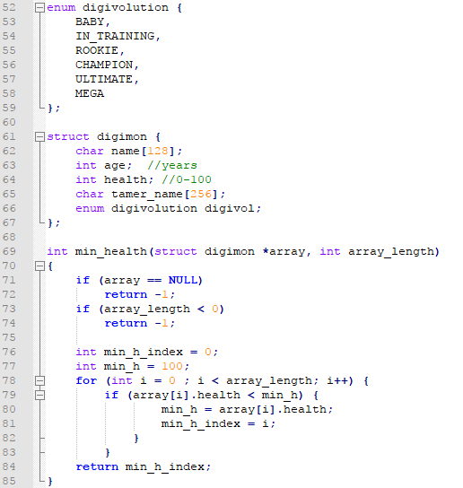
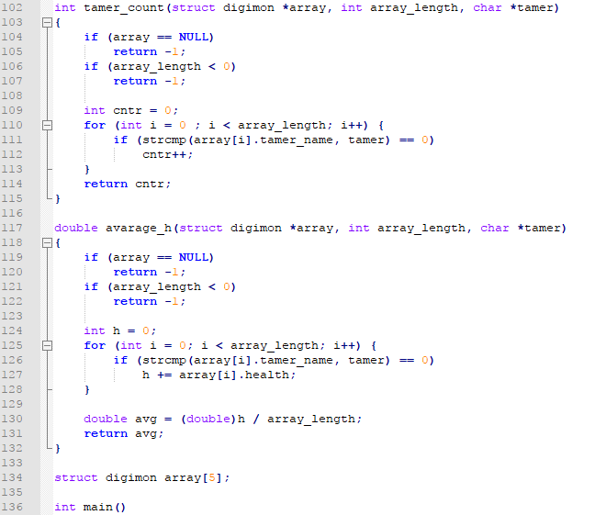
Basic Exam…

Slide 5
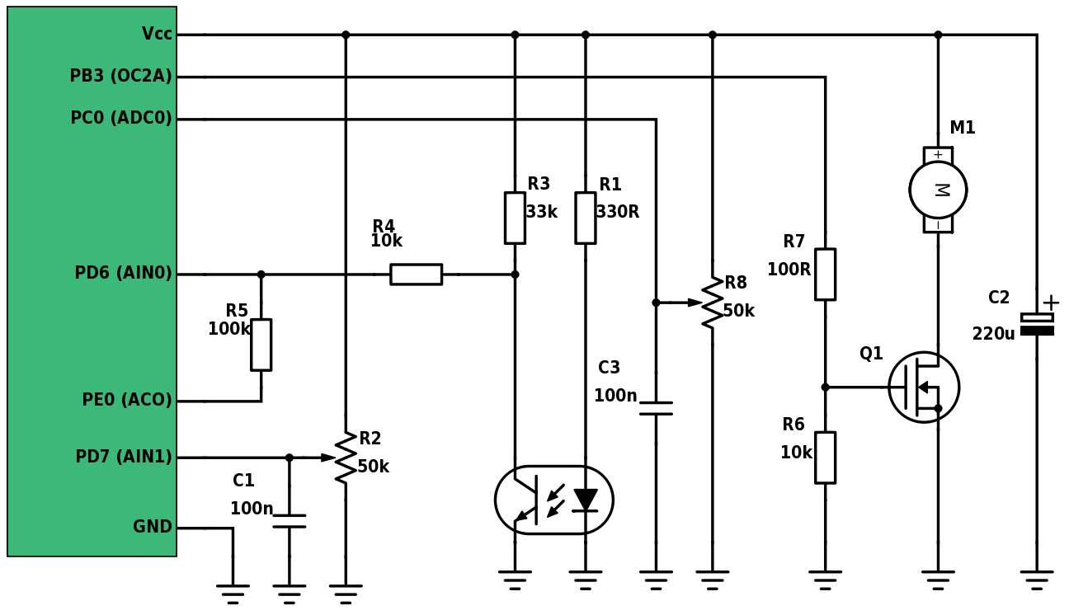
Circuit diagram

Slide 6
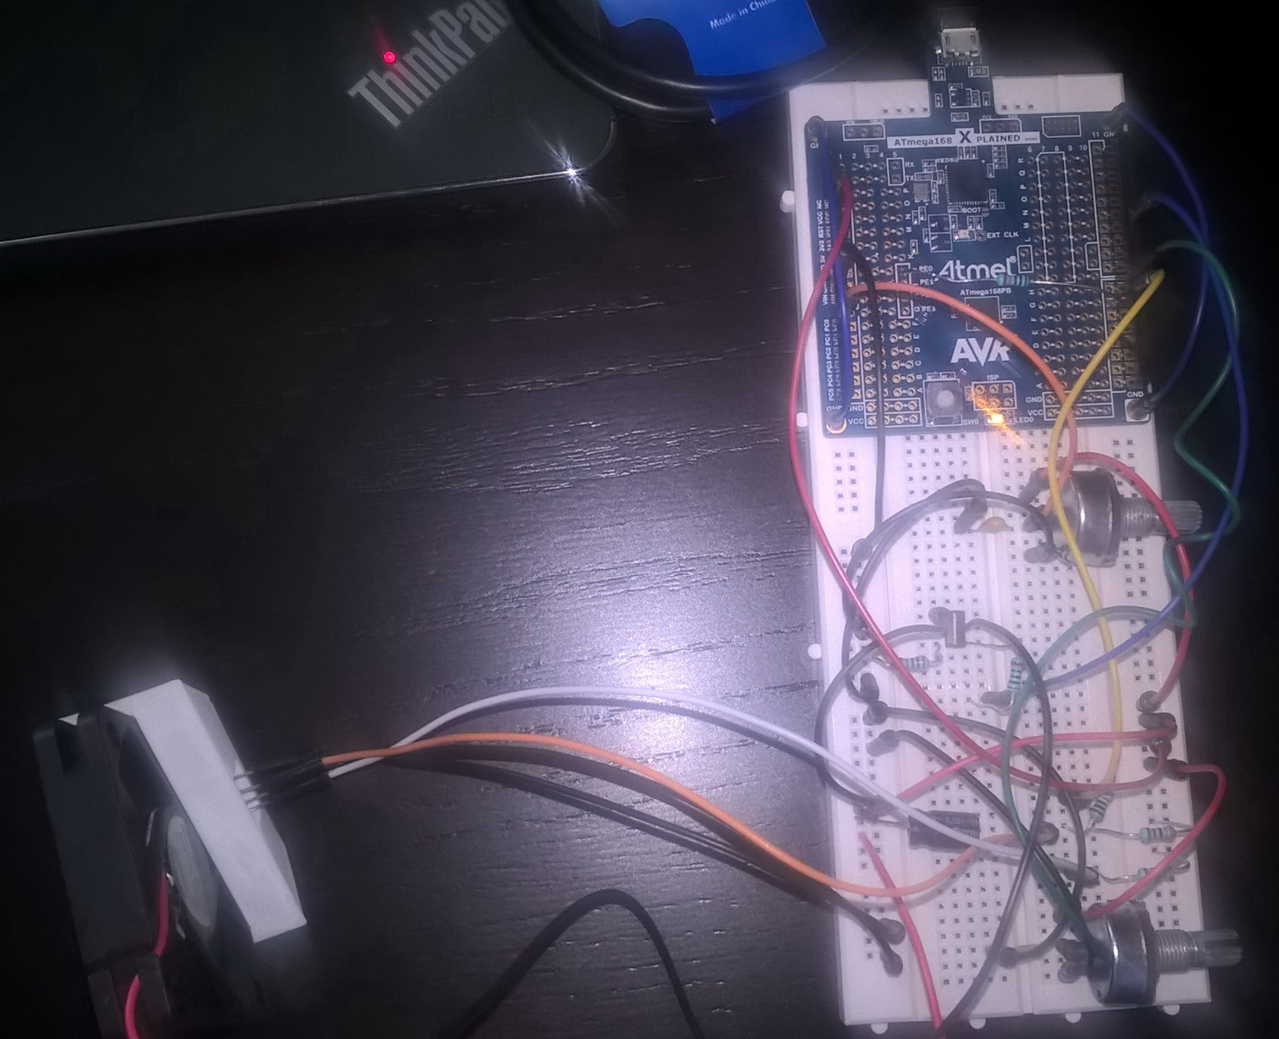
The whole device

Slide 7
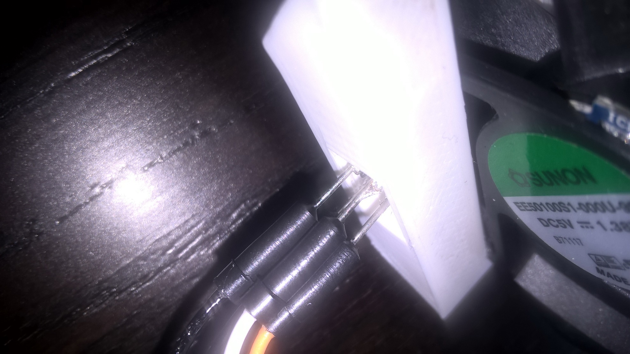
3D printed sensor holder

Slide 8
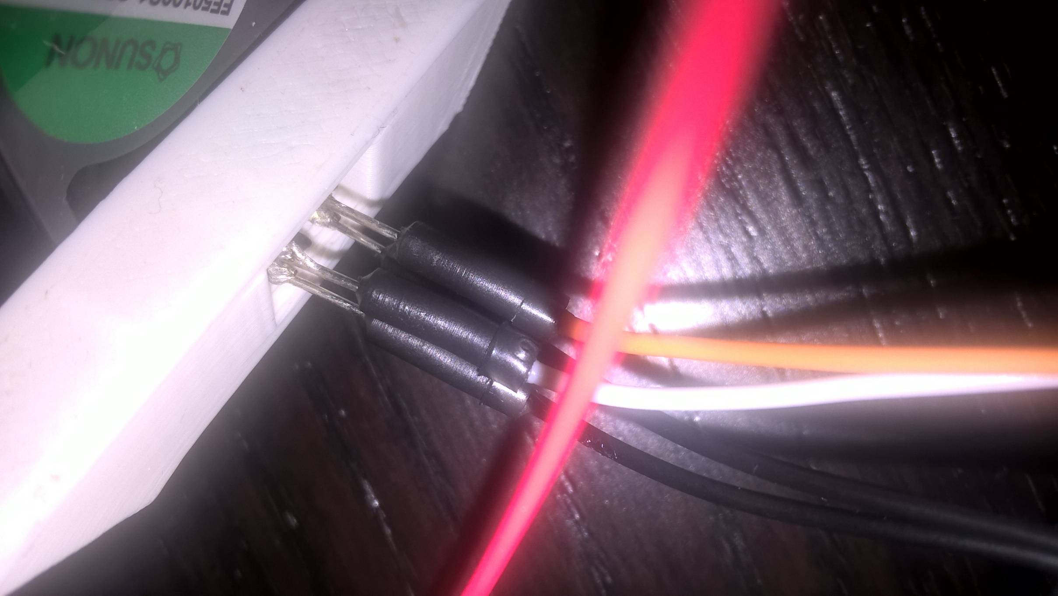

Slide 9
Schmooze…

Slide 10
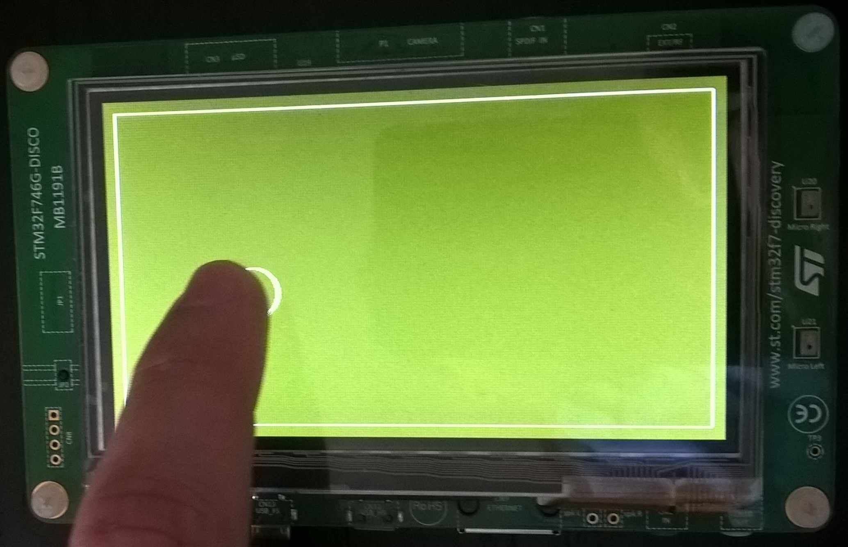
Touchpad
:)

